Slide 1
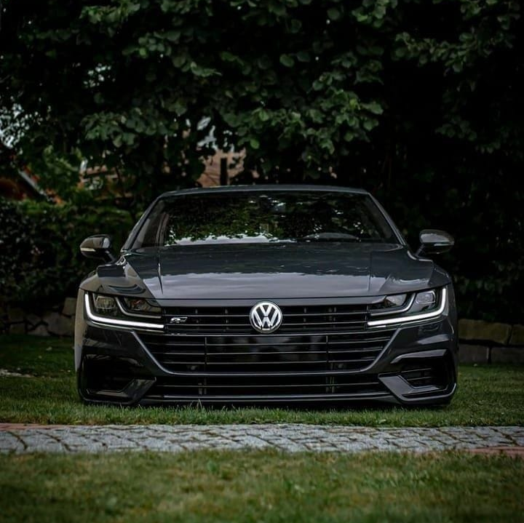

VOlKSWAGEN
The people’s car

Slide 2
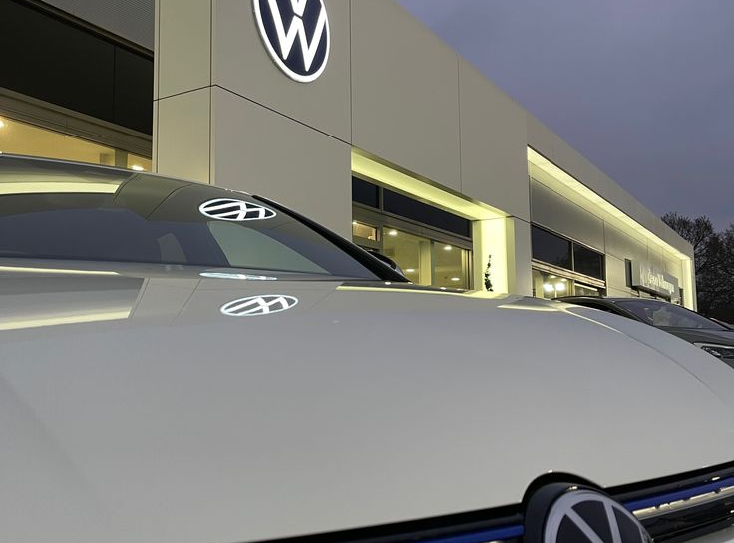
Volkswagen
Volkswagen, often abbreviated as VW, is one of the world’s largest and most well-known automobile manufacturers. Founded in 1937 in Germany, Volkswagen was created as a state-owned company by the German Labor Front. The name "Volkswagen" translates to "People's Car" in German, reflecting its original purpose to produce affordable, reliable cars for the masses.

Slide 3
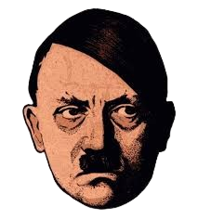

The name "Volkswagen" translates to "People's Car" in German. The main idea behind Volkswagen was to make Affordable and Reliable cars for the common people.
Hitler personally envisioned the "people's car" that could be sold for less price and he involved engineer Ferdinand Porsche in its design.
At a Nazi rally in 1938, He declared that the car was built to meet the transportation needs of the broad masses.

Slide 4
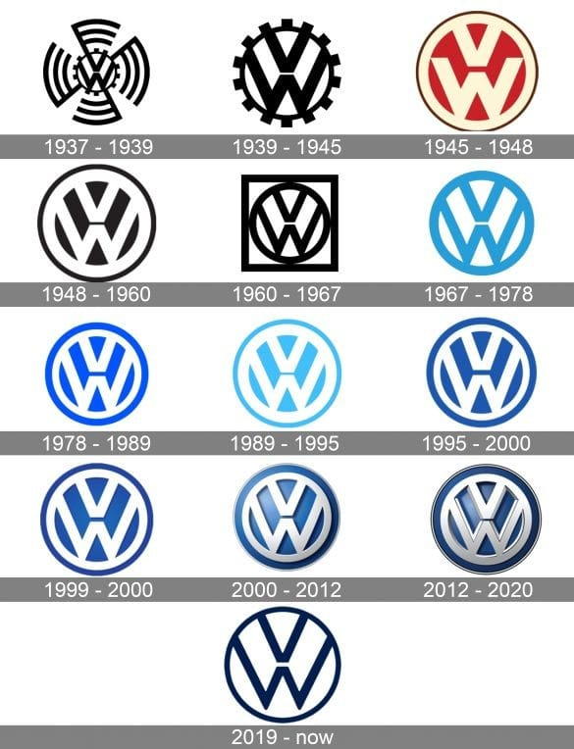
Evolution of Volkswagen as brand

Slide 5
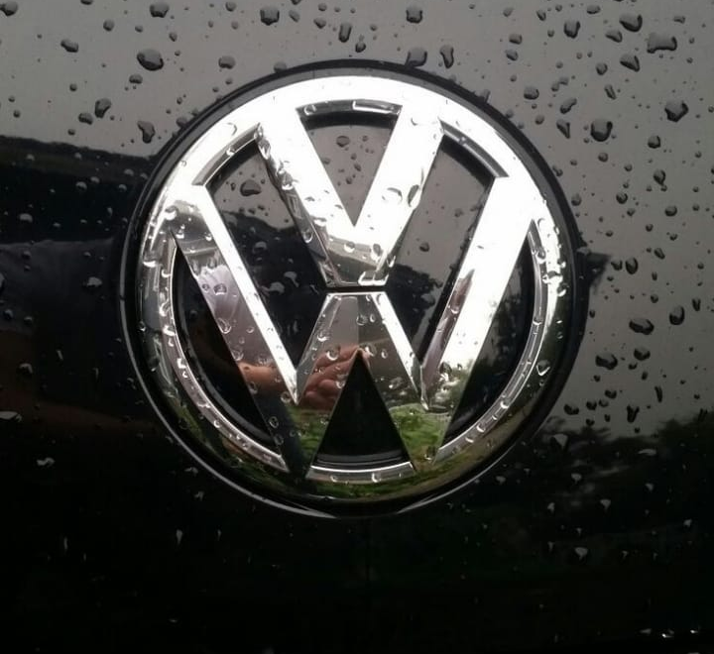
Mission Statement
Mobility for generations to come .Focus on sustainable mobility solutions.
Volkswagen’s commitment to providing transportation options . Focusing on serving the needs and desires of customers.
The mission statement of Volkswagen purpose is to provide solutions to people for transportation and connect places .

Slide 6
Vision
Innovation and technology leaders .
Sustainability and environmental protection .
Customer satisfaction and quality excellence.
To become the most innovative volume manufacturer and leading provider of sustainable mobility
To be so effective that we are able to be helpful to others
Core value

Slide 7
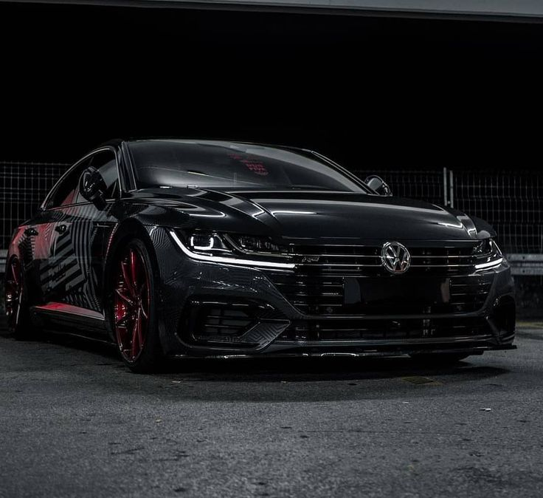
Key Analysis
Customer convenience and diverse needs. Accountability, ethics and passion.
Commitment towards the customer.
To become the global leader in electric vehicles, Volkswagen is aiming to make a significant commitment towards electrifying its products lineup.
The brand carries a strong recognition and trust in many market which contributes in the company’s success.

Slide 8
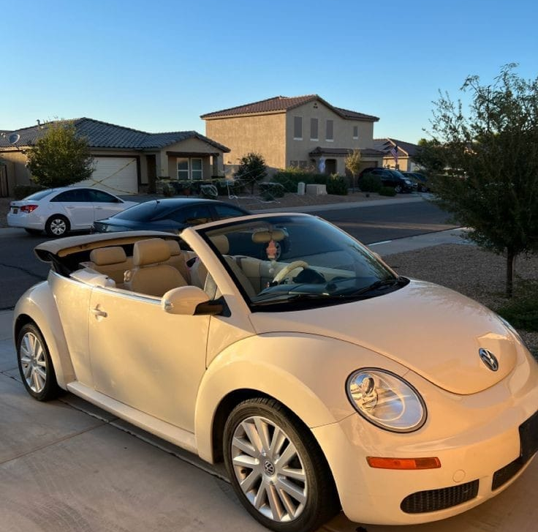
Volkswagen’s pRODUCT
Passenger Vehicles
Electric Vehicle
Volkswagen Golf
Passat
Polo
Jetta
Tiguan
Touareg
ID.Series
ID.3
ID.4
ID.5
ID.Buzz

Slide 9
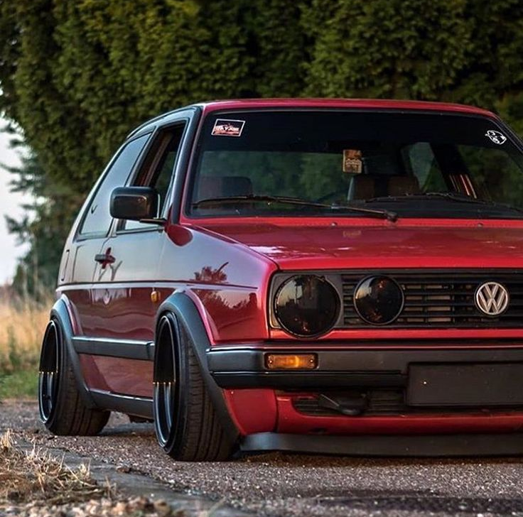
Products
Commercial Vehicles
Luxury Brands Under Volkswagen Group
Transporter
Caddy
Crafter
Amarok
Audi
Porsche
Bentley
Lamborghini
Bugatti

Slide 10

Purpose of Existance
Commitment to reducing CO2 emissions and adhering to the Paris climate agreement.
The company aims to be a leader in providing efficient service.
The company strives to meet the diverse needs and preferences of its customers .
It is dedicated to developing cutting- edge technologies and products

Slide 11
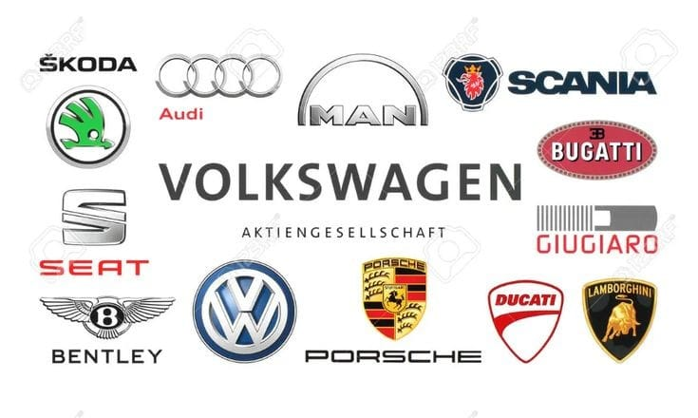
Market Analysis
Competitors( Global)
Toyota
Honda
Ford
General motors
Hyundai
Kia

Slide 12


Regional
Renault
Peugeot - Citroen
BMW
Mercedes-Benz
Audi
USP
The unique selling proposition of VW is that its products are more
fuel efficient and environment friendly i.e. It burns less fuel.
Blue Motion is a technology used by VW that reduces the size of
the engine that runs on petrol or diesel.

Slide 13
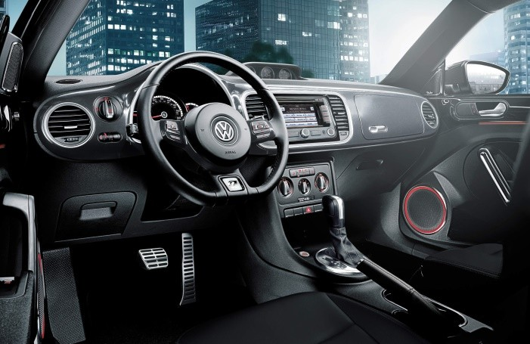
Market Trends
Electrification - Increasing demand of Electric vehicles in the growing-markets
Autonomous driving- The advancement of self - driving car technologies
Sustainability- The generational demand of environmental friendly production.

Slide 14
JJK
SWOT
Strength
Weakness
Strong Brand Recognition
Global presence
Diverse products lineup
Engineering expertise
S
W
Volkswagen are the dependence on diesel engines, which increases the challenges emerging in the market for the company
Opportunities
Threats
O
T
One of the leading opportunities for the company is the growth of electric vehicle in the market and also the expansion into new regions.
Economic fluctuations
Intense competition
Regulatory change

Slide 15
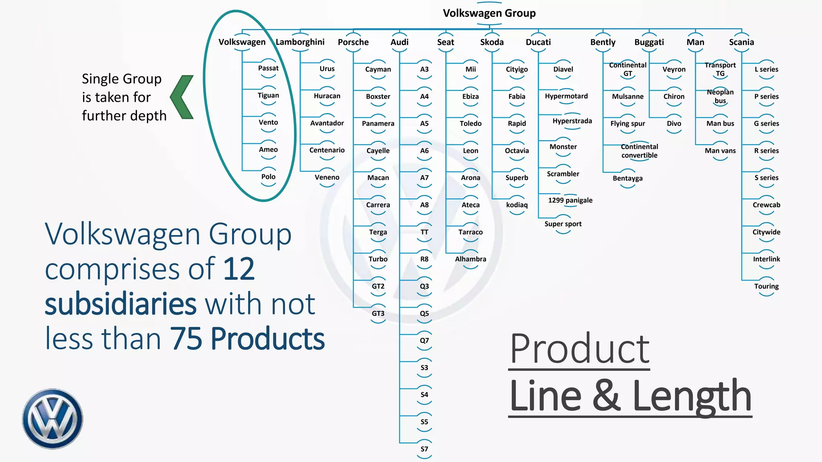

Slide 16
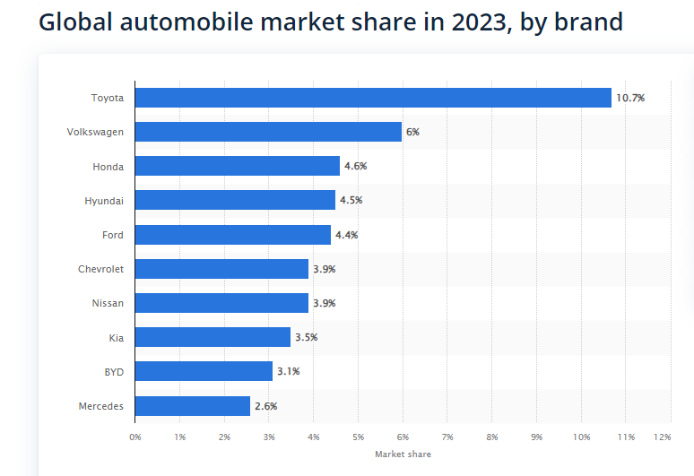

Slide 17
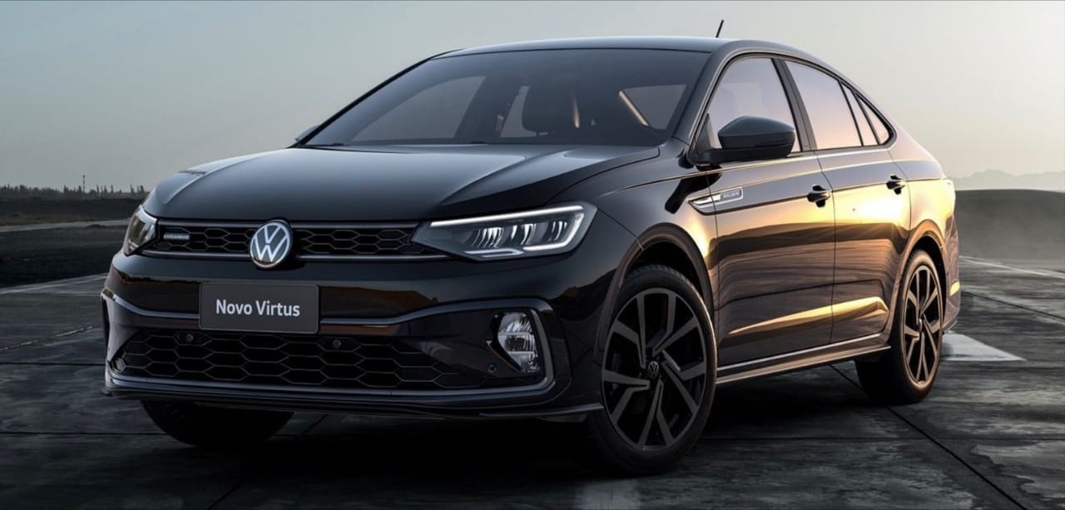
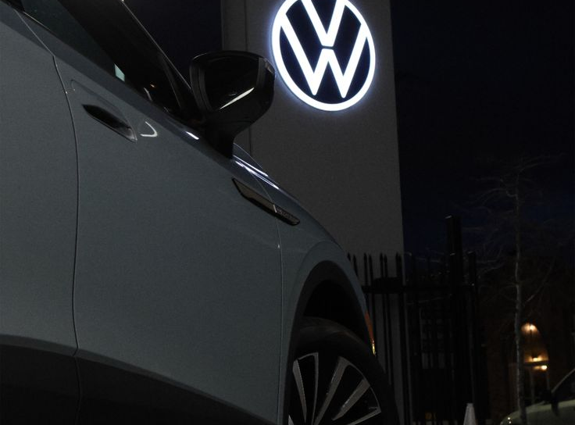
conclusion
Volkswagen has established itself as a leading automotive manufacturer through its strong strategic branding , diverse products lineup and commitment towards customers preferences and satisfaction. By understanding the market , company’s competitors and trends , Volkswagen can continue to innovate and thrive in the competition of automotive industry.

Slide 18


Slide 19
Thank you

